Slide 1
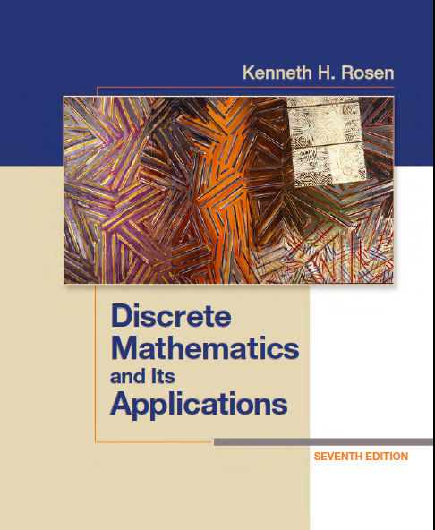
Discrete Math
Haiming Chen
Associate Professor, PhD
Department of Computer Science,
Ningbo University
http://www.chenhaiming.cn

Slide 2
Curriculum Progress
Part I：Logic （Thinking in Mathematics）
Propositional Logic, Predicates and Quantifiers
Definition, Theorem, Corollary and Proofs (Induction)
Part II：Combinatorial Counting
The Basic of Counting
The Pigeonhole Principle
Permutation and Combination
Binomial Coefficients and Combinations
Lists and Sequences (Recursive Definition /Recurrence Relations)
Part III: Discrete Structure
Sets
Functions
Relations
Graphs
Trees
Part IV: Algebra
Algebra (Groups) *
Boolean Algebra

Slide 3
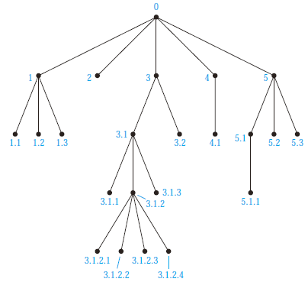
Universal Address Systems

Slide 4
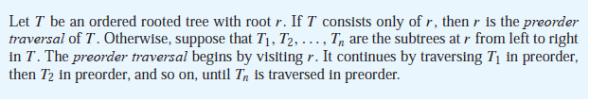
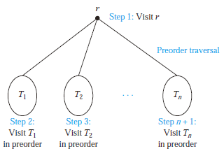
Preorder traversal

Slide 5
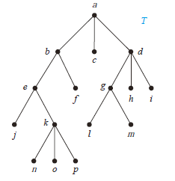
Example

Slide 6
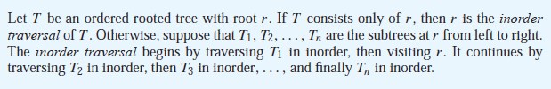
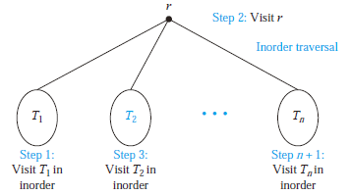
Inorder Traversal

Slide 7
Example

Slide 8

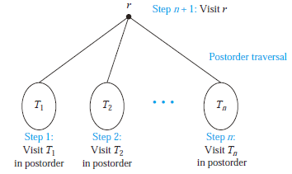
Postorder Traversal

Slide 9
Example

Slide 10
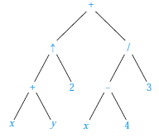
Infix form
((x + y)↑2) + ((x − 4)/3)
prefix form?
Polish notation
unambiguous

Slide 11
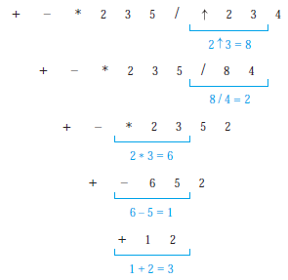
Prefix form
+ − ∗ 2 3 5/↑ 2 3 4

Slide 12
Postfix form
((x + y) ↑ 2) + ((x − 4)/3)
Reverse Polish notation

Slide 13
Postfix form
7 2 3 ∗ − 4 ↑ 9 3/+

Slide 14
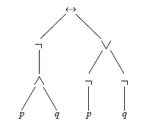
Example
(￢(p ∧ q)) ↔ (￢p ∨￢q)

Slide 15
Homework
Chapter 11.4
8, 11, 14, 18, 22(a), 24(a)

